Slide 1
ECE-200 - Fall 2008
Digital Logic Design
Week 1: Lectures 1 & 2
Introduction, number systems, and arithmetic operations
Prof. Naga Kandasamy
ECE Department
Drexel University

Slide 2
About the Course
Textbook: Design Design, 4th Edition, M. Morris Mano and Michael D. Ciletti, Pearson Prentice Hall, 2007
Grade breakdown
  Final exam: 35%
  Midterm exam: 25%
  Homework: 15%
  Quizzes: 15% (Occasional quizzes in recitation/lecture; no make-up quizzes and lowest grade will be dropped)
  Mini-labs: 10%

Slide 3
Course Web Site
We will use WebCT to host the course web site
  http://learning.dcollege.net/ (allow pop-up windows)
  Look at lecture (ECE-200-A) section and not recitations
  This site contains
    Course syllabus
    Click on “Course Contents” to access
      Lecture slides
      Homework Assignments (click on Assignments)
      Homework Solutions (click on Solutions)
      Lab Information (click on Labs)
    Grades (click on My Grades)
Text Web Site (http://www.writphotec.com/mano4/)

Slide 4
Administrative Details
Homework is due each Wednesday IN CLASS, and will be returned during the recitation sections
  Each homework must have your name, and recitation section, and must be stapled
Late homework will be penalized very harshly
Homework will not be accepted after solutions are posted
The course syllabus is on the web
All instructors and teaching assistants have office hours
  See web site and syllabus
  Available by e-mail, phone, or by appointment
Help and tutoring is available through DCLI (Drexel Center for learning and instruction)
  dcli@drexel.edu

Slide 5
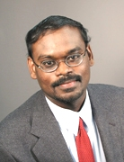
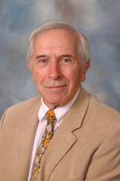
Course Instructors
Lecture Professor
Dr. Naga Kandasamy
603 Bossone Building
215-895-1996
kandasamy@ece.drexel.edu
Office Hours: T 4-6 or by appointment
Recitation Professor
Dr. Oleh Tretiak
610 Bossone Building
215-895-2214
taskin@coe.drexel.edu
Office Hours: TBD

Slide 6
Teaching Assistants
Mr. Rui Wang
324 Bossone Building
215-895-1881
rw366@drexel.edu
Office hours: Tuesday, 10 – 12 am
Mr. Non Yok
325 Bossone Building
ng39@drexel.edu
Office hours: Monday, 2 – 3 pm, and Wednesday, 2 – 3 pm

Slide 7
Suggestions
Incomplete note sets will be posted on web site
  I HIGHLY recommend printing them and completing the notes during lecture
Homework, quizzes, mini-labs count!
  Best grade you can get without them is a C
    Homework, etc. can spell the difference between an F and passing the course
If you have questions
    Study the notes
    Read the book
    Come see us
    Set up tutoring with DLC

Slide 8
Why Digital Logic?
This is a foundational course for all electrical and computer engineers, computer scientists
Needed to understand
  Computer architecture
  Operating systems
  Design of computer systems
Computing is exciting these days ...
  There are design challenges in power, performance, verification, ....

Slide 9
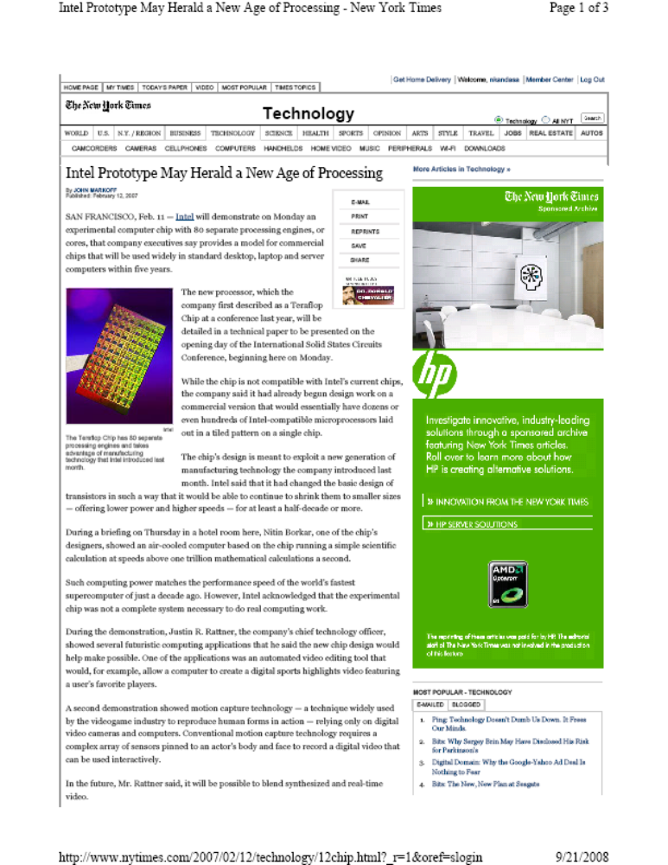
Why Digital Logic?
Designing for performance
Eighty processors on
a single chip!!

Slide 10
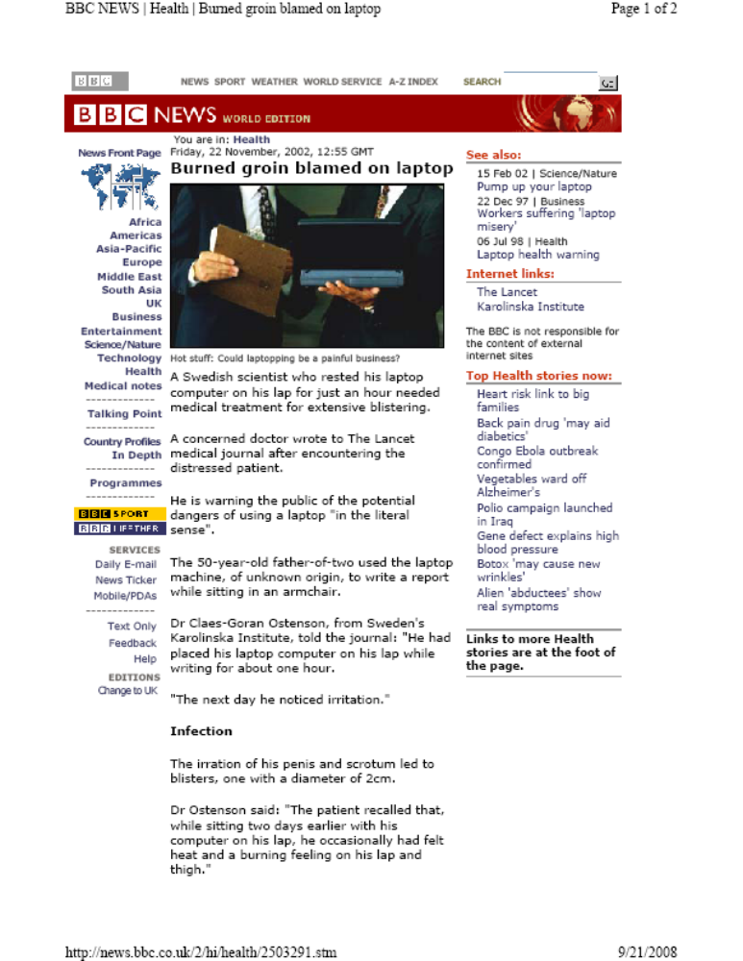
Why Digital Logic?
Designing for power

Slide 11
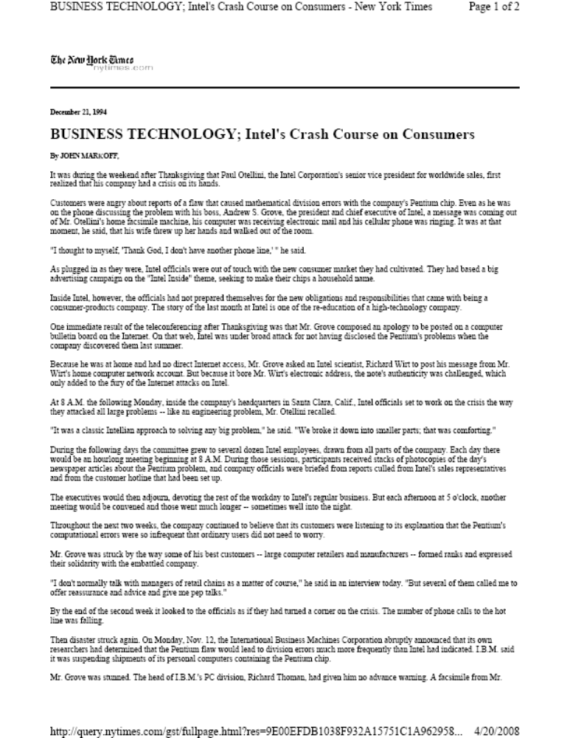
Why Digital Logic?
Design verification

Slide 12
Back to nuts and bolts: Course Syllabus
  Chapter 1: Digital Systems and Binary Numbers
  Chapter 2: Boolean Algebra and Logic Gates
  Chapter 3: Gate-Level Minimization
  Chapter 4: Combinational Logic
  Chapter 5: Synchronous Sequential Logic
  Chapter 6: Registers and Counters
  Chapter 7: Memory and Programmable Logic

Slide 13
Digital Computers and Information
The key characteristic of a digital system is its manipulation of discrete elements of information (e.g., 10 decimal digits)
Early computers were used mostly for numeric computations and the discrete elements used were digits
Discrete elements of information are represented by physical quantities called signals (e.g., voltage)
Signals in most digital systems use just two discrete values, thereby said to be binary

Slide 14
Digital Computers and Information (Contd.)
Electronic digital devices do not contain magical ‘0’s and ‘1’s
  Input or output to a gate is a certain value of voltage

Slide 15
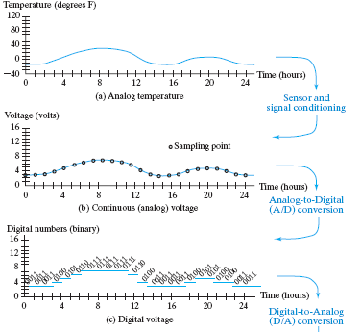
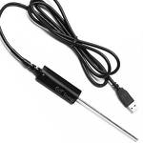
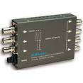
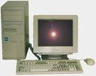
Digital Computers and Information (Contd.)
Computers require digital information
Example of analog to digital conversion
Sensor
A/D Converter
Computer

Slide 16
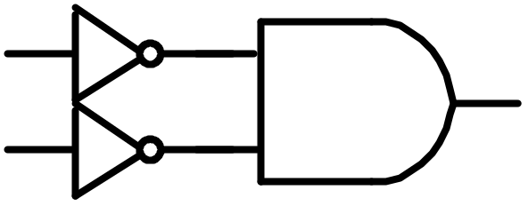
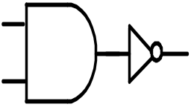
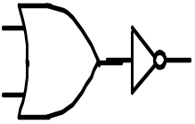
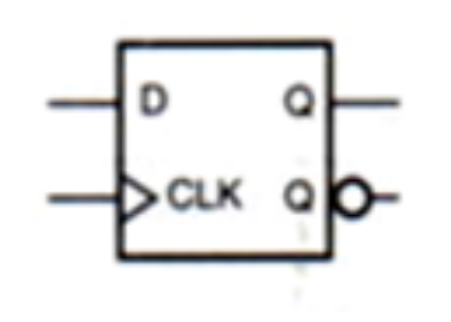

Digital Devices
Digital devices are built using gates
A typical gate has one or more inputs and one output
NOT Gate
AND Gate
OR Gate
A Flip-Flop or Latch is a device that stores a 1 or a 0

Slide 17
Number Systems
Much of digital system processing is numeric
Many ways of representing numbers
  Decimal: 24, Roman: XXIV
Most common scheme for representing numbers is the radix (or base) representation
For manual calculations, we use a radix of 10, that is decimal numbers
In computers, the basic symbols are binary, that is, 0 and 1
Octal and Hexadecimal numbers are compact ways of representing binary numbers

Slide 18
Decimal Numbers
The value of the decimal ‘number’ 845 (eight forty five) is computed as follows:
The value of the decimal ‘number’ 12.4 (twelve point four) is computed as follows:

Slide 19
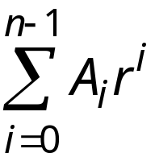
Radix Representation
A sequence A_{n-1} , A_{n-2}, ... , A₁, A₀, consisting of n digits
(0 ≤ A_{i} < r), where r is a positive integer represents the number
r is the
A is the
i is the
r = 10, decimal, digits 0, 1, … 9
r = 2, binary, digits 0, 1
r = 8, octal
r = 16, hexadecimal
NOTES: Radix is often called Base
Notice in Digital Logic, we will start counting with

Slide 20
Examples of Radix Numbers
Radix = 2 (binary number)
11010₂ = ?₁₀
Base = 5 (quintinary number)
131₅ = ?₁₀
Base 2 number with a radix point
101.01₂ = ?₁₀

Slide 21
Octal and Hexadecimal Numbers
Octal (base 8) and hexadecimal (base 16) numbers are used to compactly represent binary numbers
Octal digits: 0, 1, 2, 3, 4, 5, 6, 7
127₈ = ?₁₀
Hexadecimal (hex) digits: 0, 1, ..., 9, A=10, B=11, C=12, D=13, E=14, F=15
1AB₁₆ = ?₁₀

Slide 22
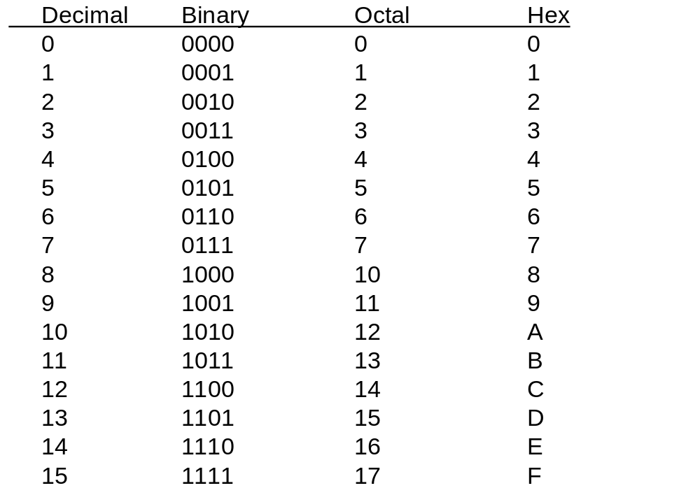
Common Numbers and Bases

Slide 23
Conversion Between Bases
Any base to decimal
  Use radix numbers
Decimal (integer) to any base
  Divide the number and all successive quotients by the base that we are converting to until the quotient is zero
  Accumulate the remainders
  The last remainder is the most significant bit (MSB)
  The first remainder is the least significant bit (LSB)

Slide 24
Convert Any Base to Decimal
Convert 1101₂ to decimal
Convert 327₈ to decimal

Slide 25
Convert Decimal to Any Base
Convert 327₁₀ to Octal
Convert 327₁₀ to Binary

Slide 26
Binary - Octal - Hex Conversions
Group bits (pad with zeros if necessary)
Binary to octal or hex: start at binary point
  1101010.01₂ to octal (groups of 3):
  1101010.01₂ to hex (groups of 4):
Why is this true?

Slide 27
Binary - Octal - Hex Conversions
Octal/Hexadecimal to binary: Expand one digit at a time into binary
  127.4₈ =
  B65F₁₆ =
How would you convert Hex to Octal (or octal to hex)?

Slide 28
Addition and Subtraction
Addition and subtraction of positional numbers is done the same way as decimal addition
  addition: sum plus carry
  subtraction: difference minus borrow
We will discuss addition and subtraction of binary numbers

Slide 29
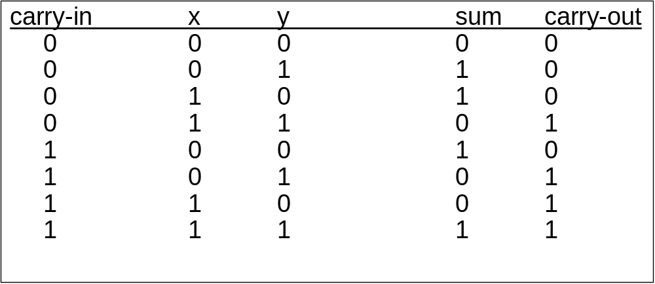
Addition in Decimal/Binary
1₁₀ + 1₁₀ =
1₁₀ + 1₁₀ + 1₁₀ =
1₂ + 1₂ =
1₂ + 1₂+ 1₂ =

Slide 30
Binary Addition
carry-in x y sum carry-out
0 0 0 0 0
0 0 1 1 0
0 1 0 1 0
0 1 1 0 1
1 0 0 1 0
1 0 1 0 1
1 1 0 0 1
1 1 1 1 1
1011
+ 0010
1011010
+ 0011101
11011011
+ 01110111

Slide 31
Binary Subtraction
Use subtraction table or same borrowing technique as decimal
borrow-in x y diff borrow-out
0 0 0 0 0
0 0 1 1 1
0 1 0 1 0
0 1 1 0 0
1 0 0 1 1
1 0 1 0 1
1 1 0 0 0
1 1 1 1 1
decimal
binary
45
- 29
10
- 01

Slide 32
Binary Subtraction
Subtract the smaller number (magnitude) from the larger number
borrow-in x y diff borrow-out
0 0 0 0 0
0 0 1 1 1
0 1 0 1 0
0 1 1 0 0
1 0 0 1 1
1 0 1 0 1
1 1 0 0 0
1 1 1 1 1
1011
- 0110
11011011
- 00101111
10110111
- 00011100

Slide 33
Binary Multiplication
1011
x 101

Slide 34
Arithmetic Overflow
In a computer, a fixed number of bits are available for a number representation
  Byte = 8 bits
  Short integer = 16 bits (2 bytes)
  Long integer = 32 bits (4 bytes)
When we perform an addition, the sum may be too large to fit into the available number of bits. This event is called overflow
Same thing can happen when we subtract

Slide 35
Number Ranges
What is the largest number that can be represented by an n bit binary number?
What is the largest number that can be represented by a general n bit number?

Slide 36
Number Representation
So far, we have considered only POSITIVE numbers
We need other numerical representation to account for positive and negative numbers
  Unsigned Numbers (what we have done so far)
  Signed Magnitude Numbers
  Two’s Complement
We will determine what is best for addition and subtraction

Slide 37
Unsigned vs Signed Numbers
Suppose we have 8 bits, we can represent numbers between 0 and 255₁₀ (these are called unsigned numbers)
In many applications, we want to represent both positive and negative numbers
  The same 8 bits can be used to represent numbers between -127 and +127
Sign-magnitude: The most significant bit (MSB) encodes the sign
85 = 01010101 -85 = 11010101
-127 = 11111111 127 =
+0 = -0 =

Slide 38
Signed Magnitude Representation
Why is this not commonly used?
What is the range of signed magnitude?

Slide 39
Two’s Complement Notation
Use an n bit register.
Signed magnitude number, but the sign bit is now part of the number
The most significant bit represents the sign
  MSB = 0 = positive number
  MSB = 1 = negative number

Slide 40
Two’s Complement Representation of Decimal Numbers
if the number is positive
  Exact same representation as an unsigned number
if number is negative (or to switch from positive to negative or vise versa)
  Complement all bits
  Binary add +1 (ignore final carry)
ALWAYS use same number of bits (typically 8)
55 = 00110111 -55 = ??

Slide 41
Determine Decimal Value of 2’s Complement Number
if the number is positive
  Use the same technique as unsigned numbers
if the number is negative: Use on of two ways
For the following 8 bit 2’s complement numbers, find decimal values:
00101011 10010111 10010111

Slide 42
What is the range of 2’s complement numbers?
For a 4-bit 2’s complement system
For a n-bit 2’s complement system

Slide 43
Arithmetic of Signed Numbers
Addition of two’s complement binary numbers
  Same as that of unsigned numbers
However, the same addition technique is ALSO valid for subtraction. How?
Due to this fact, this is the preferred method for addition and subtraction in computers
Computer ALUs (Arithmetic Logic Units) use 2’s complement form – Only an adder is required!

Slide 44
Addition (Subtraction) with 2’s Complement numbers
Number of bits must be the same in all input AND output numbers
What do with final carry? Ignore It!
Overflow (out of bounds or range): Check Sign Bits!
  Overflow is only possible when adding like-sign numbers
    Occurs when adding two positive numbers, and the result is negative (Check MSB)
    Occurs when adding two negative numbers, and the result is positive (Check MSB)
  When adding a positive and negative number, no overflow will occur

Slide 45
Overflow
If we add two n-bit numbers, and the sum occupies n + 1 bits, we say an overflow occurs
Overflow is a problem in computers because the number of bits that hold a number is fixed

Slide 46
Addition (Subtraction) with 8-bit 2’s Complement
92: 01011100 45: 00101101
92 - 92 92
-45 +45 +45
-92
-45
Overflow?

